Slide 1
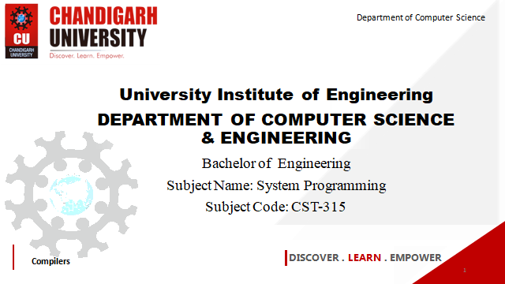

Department of Computer Science
University Institute of Engineering
DEPARTMENT OF COMPUTER SCIENCE & ENGINEERING
Bachelor of Engineering
Subject Name: System Programming
Subject Code: CST-281
Compilers
DISCOVER . LEARN . EMPOWER

Slide 2
Chapter-1.1 Overview of System Software
Department of computer Science
Different Views on the Meaning of a Program
System Software Development

Slide 3
Different Views on the Meaning of a Program
In computing, a program is a specific set of ordered operations for a computer to perform. In the modern computer that John von Neumann outlined in 1945, the program contains a one-at-a-time sequence of instructions that the computer follows.
A program is also a special kind of data that indicates how to operate on application or user data. Computer programs can be characterized as interactive or batch in terms of what drives them and how continuously they run.
Computer program, detailed plan or procedure for solving a problem with a computer; more specifically, an unambiguous, ordered sequence of computational instructions necessary to achieve such a solution.
Computer program, detailed plan or procedure for solving a problem with a computer; more specifically, an unambiguous, ordered sequence of computational instructions necessary to achieve such a solution.

Slide 4
System Software Development
A software development process is the process of dividing software development work into distinct phases to improve design, product management, and project management. It is also known as a software development life cycle. Software engineering is an engineering branch associated with development of software product using well-defined scientific principles, methods and procedures. The outcome of software engineering is an efficient and reliable software product. OR
software development process is dividing the software development into tiny, sequential steps to enhance the product, project, and design altogether. the iterative logical process for software program development or application development to cater to the needs of any business or personal objectives is known as ‘Software Development’.

Slide 5
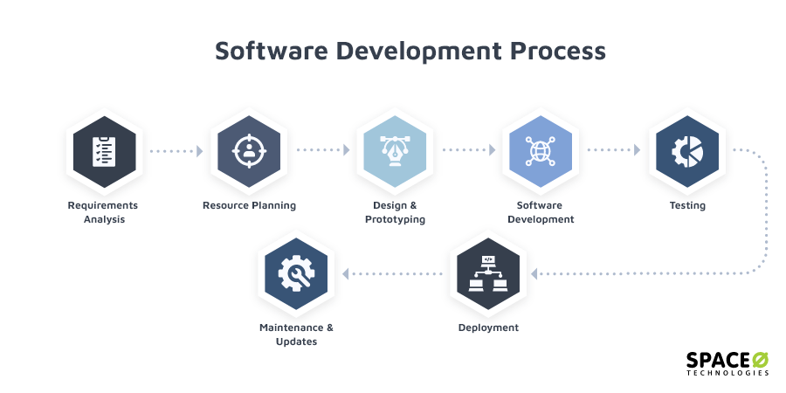
System Software Development

Slide 6
System Software Development
Requirements Analysis and Resource Planning
Design and Prototyping
Software Development
Testing
Deployment
Maintenance and Updates

Slide 7
System Software Development
Requirements Analysis and Resource Planning
The first step to any process is always planning. Being a project manager, you might have done a requirement analysis of your project, but you are going to need software engineering experts to create plan. You need to analyze if the software, you are planning to develop, aligns with your business or personal goals. This is a requirements analysis.
Design and Prototyping
After the analysis and planning part is over, it is time to start creating a software architecture for the product. This architecture or design will define the complete workflow of the software.
Software Development
Development in software-process only begins when you are completely sure of the requirements and onboard with the design and features. The development team starts working on the development of a program by writing the necessary code.

Slide 8
System Software Development
Testing
This is actually a continuous process of software development, and testing is performed alongside development. Testing is done to check the functionality, usability, and stability of the product under the rapid development process.
Deployment
This is a crucial stage in the software development life cycle. After coding and testing are done, the next development phase is to deploy your software on the necessary servers and devices. This is only done after you have approved of the product functionality and the stability of the product is proved.

Slide 9
System Software Development
Maintenance and Updates
As described earlier, software development is a cycle. It is an iterative process of software development. After launching the product, the process is not complete. You need to keep a track of software maintenance and keep upgrading it. You need to consistently monitor software development and suggest changes whenever required.

Slide 10
References
John J Donovan Systems Programming Ebook Wordpress (pdflife.one)
[PDF] Systems Programming and Operating Systems by Dhamdhere - Free Download PDF (dlscrib.com)

Slide 11
THANK YOU

